Slide 1


Communication Subsystem
By Ei Phyu Phyu

Slide 2
Outline
1. Communication MDR
Background
Function and Performance Evaluations
Product Breakdown Structure – WBS
Block Diagram for Communication Subsystem
Birds-3 UHF COMM and OBC Interface
Communication RAS (System and Design Requirements)
Schedule
2. Antenna Deployment MDR
Block Diagram for Antenna Deployment
Antenna Configuration
Antenna Deployment RAS
Schedule

Slide 3
Communication Subsystem Background
Background
Provide a link to relay data findings (satellite to ground station) and send commands to the satellite
Provide the interface between the satellite and ground systems.
Receives and demodulates uplink signals and modulates and transmits downlink signals.
Consist of a transmitter, a receiver, an antenna, and a RF duplexer or circulator
Data Relay
Payload mission data
House keeping data
Operator commands (command data) also pass to the satellite through this subsystem to control the satellite and to operate the payload
Main Objective
- To establish efficient and effective link between the space and the ground segment

Slide 4
S/N | Function | Performance Evaluations
1 | Receive uplink command from GS (Ground Station), and send the received command to OBC (On Board Computer) | UHF dipole antenna to receive 435 MHz uplink command.
 |  | Transceiver to receive and demodulate the uplink command in GMSK 4800 bps rate, and AX.25 frame format.
 |  | COMM MCU to send the command to OBC through UART.
2 | Receive the Telemetry/HK data from OBC and transmit the Telemetry/HK data to GS. | COMM MCU to receive telemetry/HK data from OBC.
 |  | Transceiver to do GMSK modulation 4800 bps rate, and AX.25 frame format to Telemetry data.
 |  | Transceiver to process CW that contains HK data.
 |  | UHF dipole antenna to transmit Telemetry/HK data using 437.375 MHz downlink frequency
3 | Receive the payload data (SF packets) from OBC and transmit data to GS. | COMM MCU to receive payload data from OBC.
 |  | Transceiver to do GMSK modulation 4800 bps rate, and AX.25 frame format to payload data.
 |  | UHF dipole antenna to transmit Telemetry/HK data using 437.375 MHz downlink frequency.

Slide 5
Product Breakdown Structure
COM
1.1.1.3
UHF Transceiver
1.1.1.3.1
COM MCU 1.1.1.3.2
COM FM 1.1.1.3.3
Antenna
1.1.1.3.4
Antenna deployment unit
1.1.1.3.5
UHF TX
1.1.1.3.1.1
Modulator
1.1.1.3.1.2
UHF RX
1.1.1.3.1.3
Demodulator
1.1.1.3.1.4
CW TX
1.1.1.3.1.5
TX/RX Antenna
1.1.1.3.4.1
Burner Circuit
1.1.1.3.5.1
Fishing Wire
1.1.1.3.5.2

Slide 6
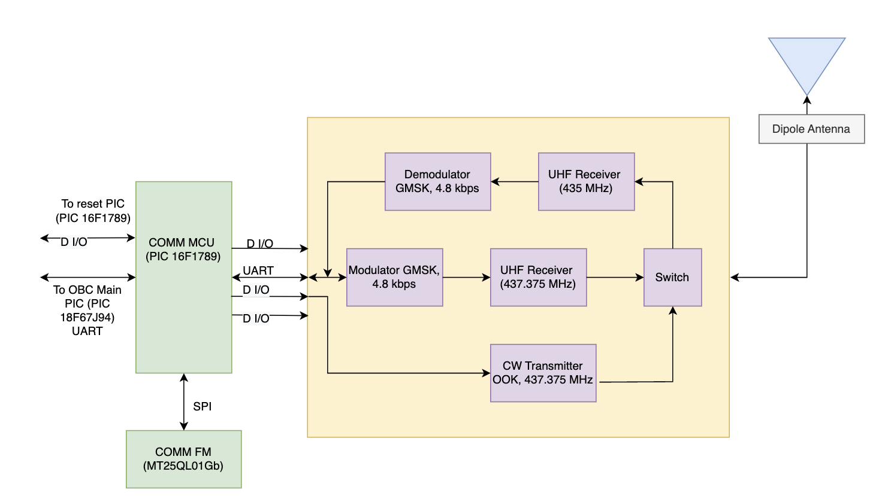
Block Diagram for Communication Subsystem
Modes of operation
TX | CW | Mode
0 | 0 | GMSK RX
1 | 0 | GMSK TX
0 | 1 | CW Mode

Slide 7
Communication Links
 | Uplink (Receive Mode) | Downlink (Transmit Mode) | Beacon (CW Mode)
Frequency | 435 MHz | 437.375 MHz | 437.375 MHz
Bandwidth | 8.5 kHz | 8.5 kHz | 500 Hz
Modulation | GMSK | GMSK | CW Morse Code
Output Power | 50W(GS) | 800mW (29.03 dBm) | 100mW (20 dBm)
Rate | 4800 bps | 4800 bps | 20 wpm

Slide 8
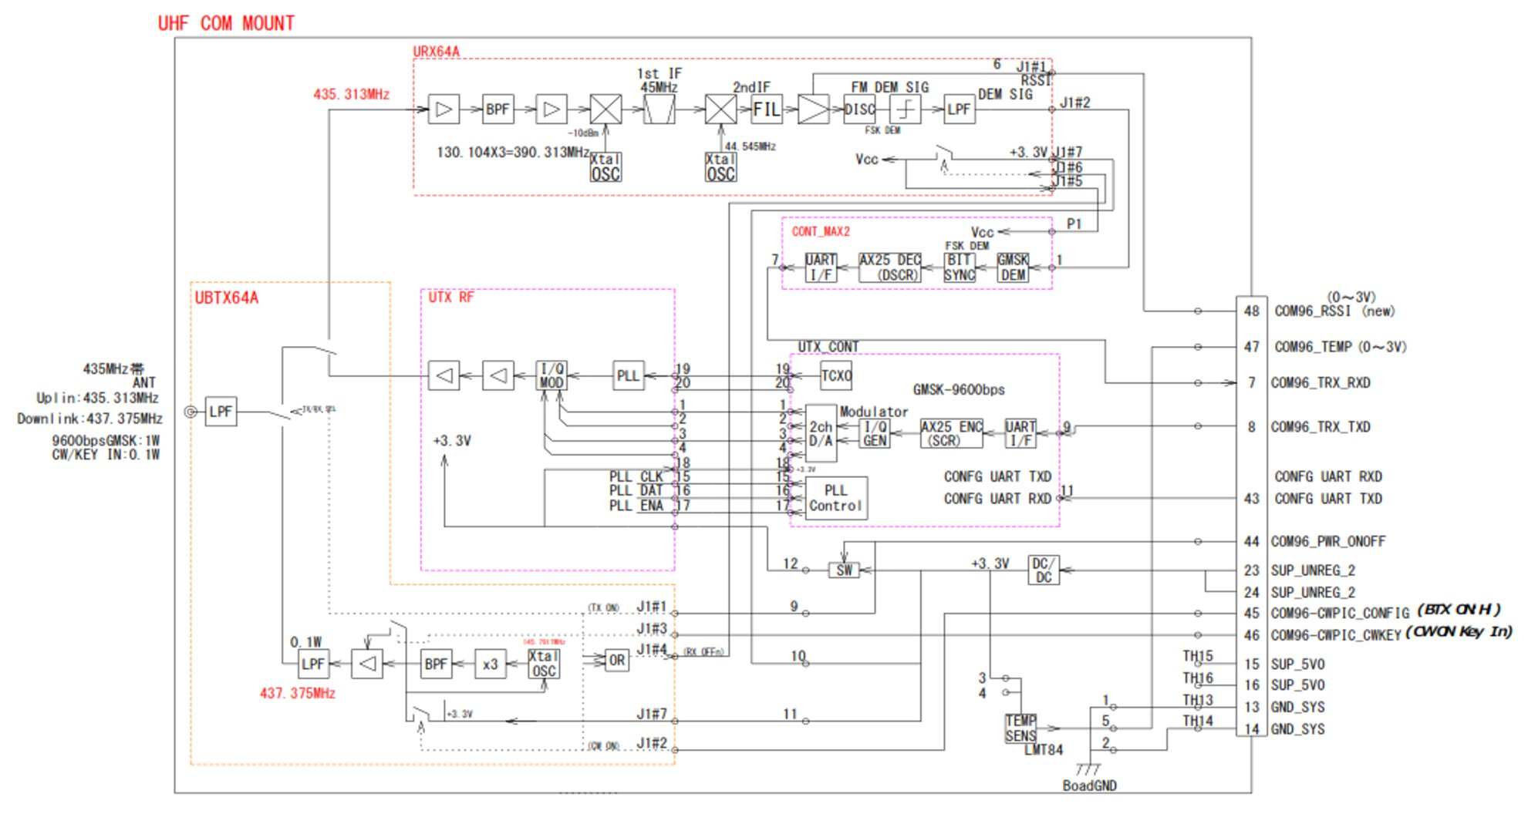
ADD1397B (UHF Transceiver)

Slide 9
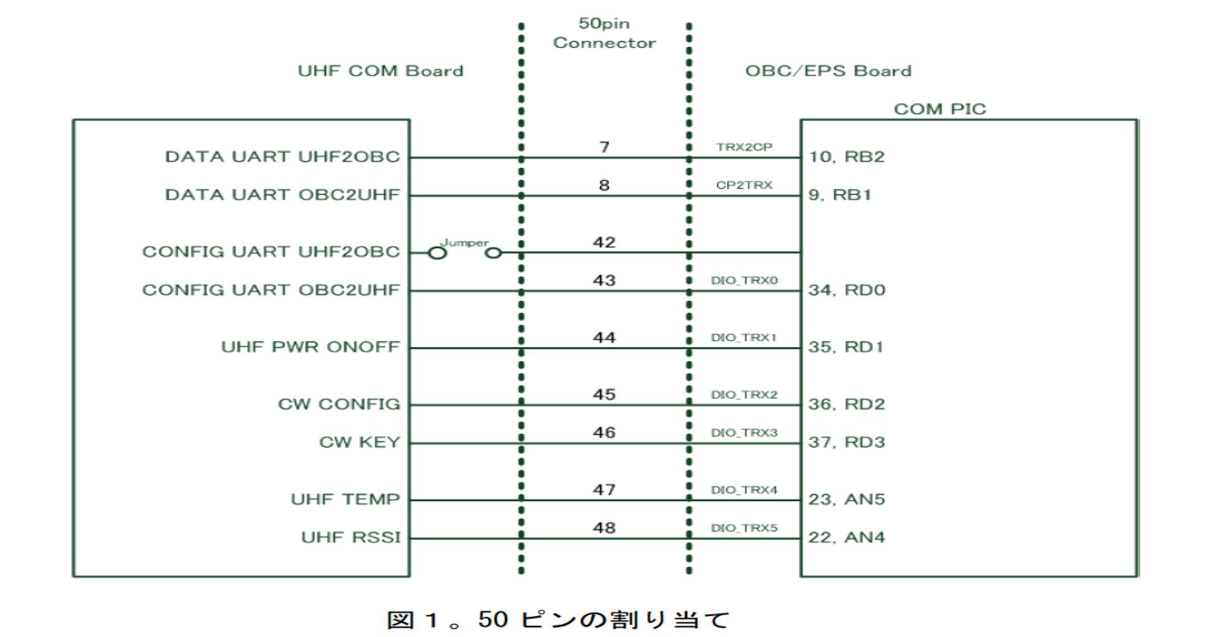
Birds-3 UHF COMM and OBC Interface

Slide 10
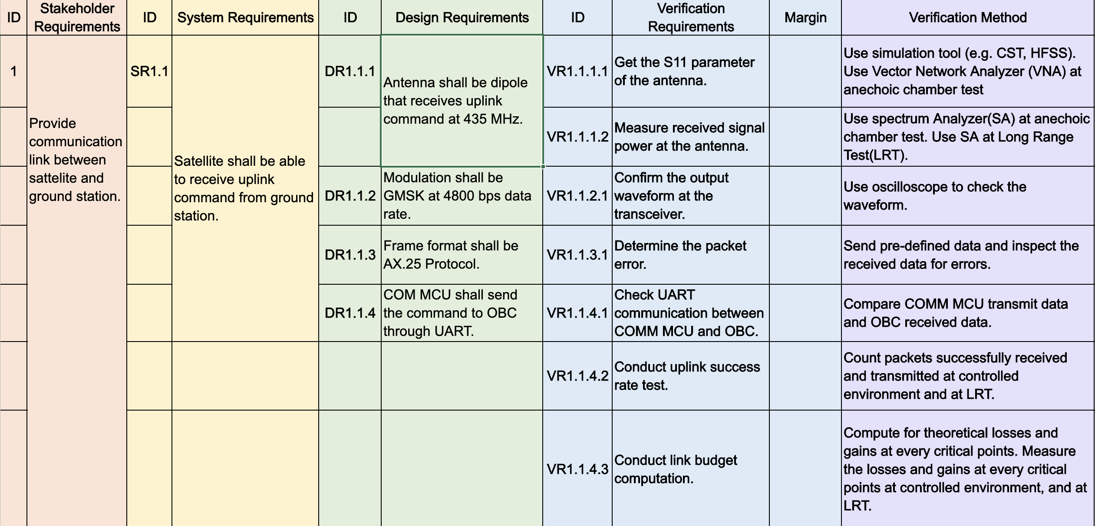
Communication RAS

Slide 11
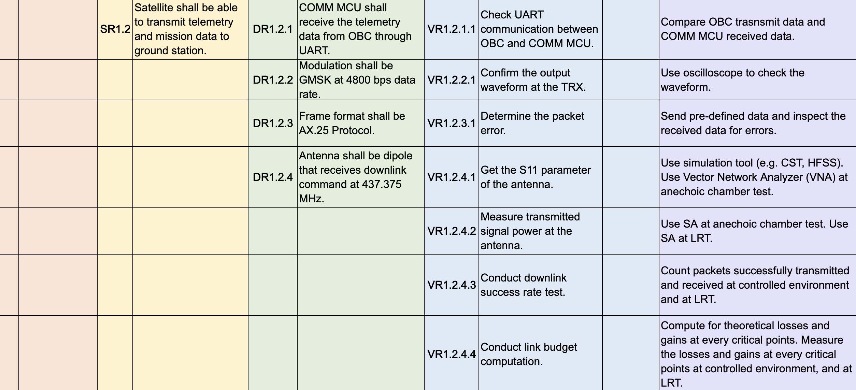
Communication RAS

Slide 12
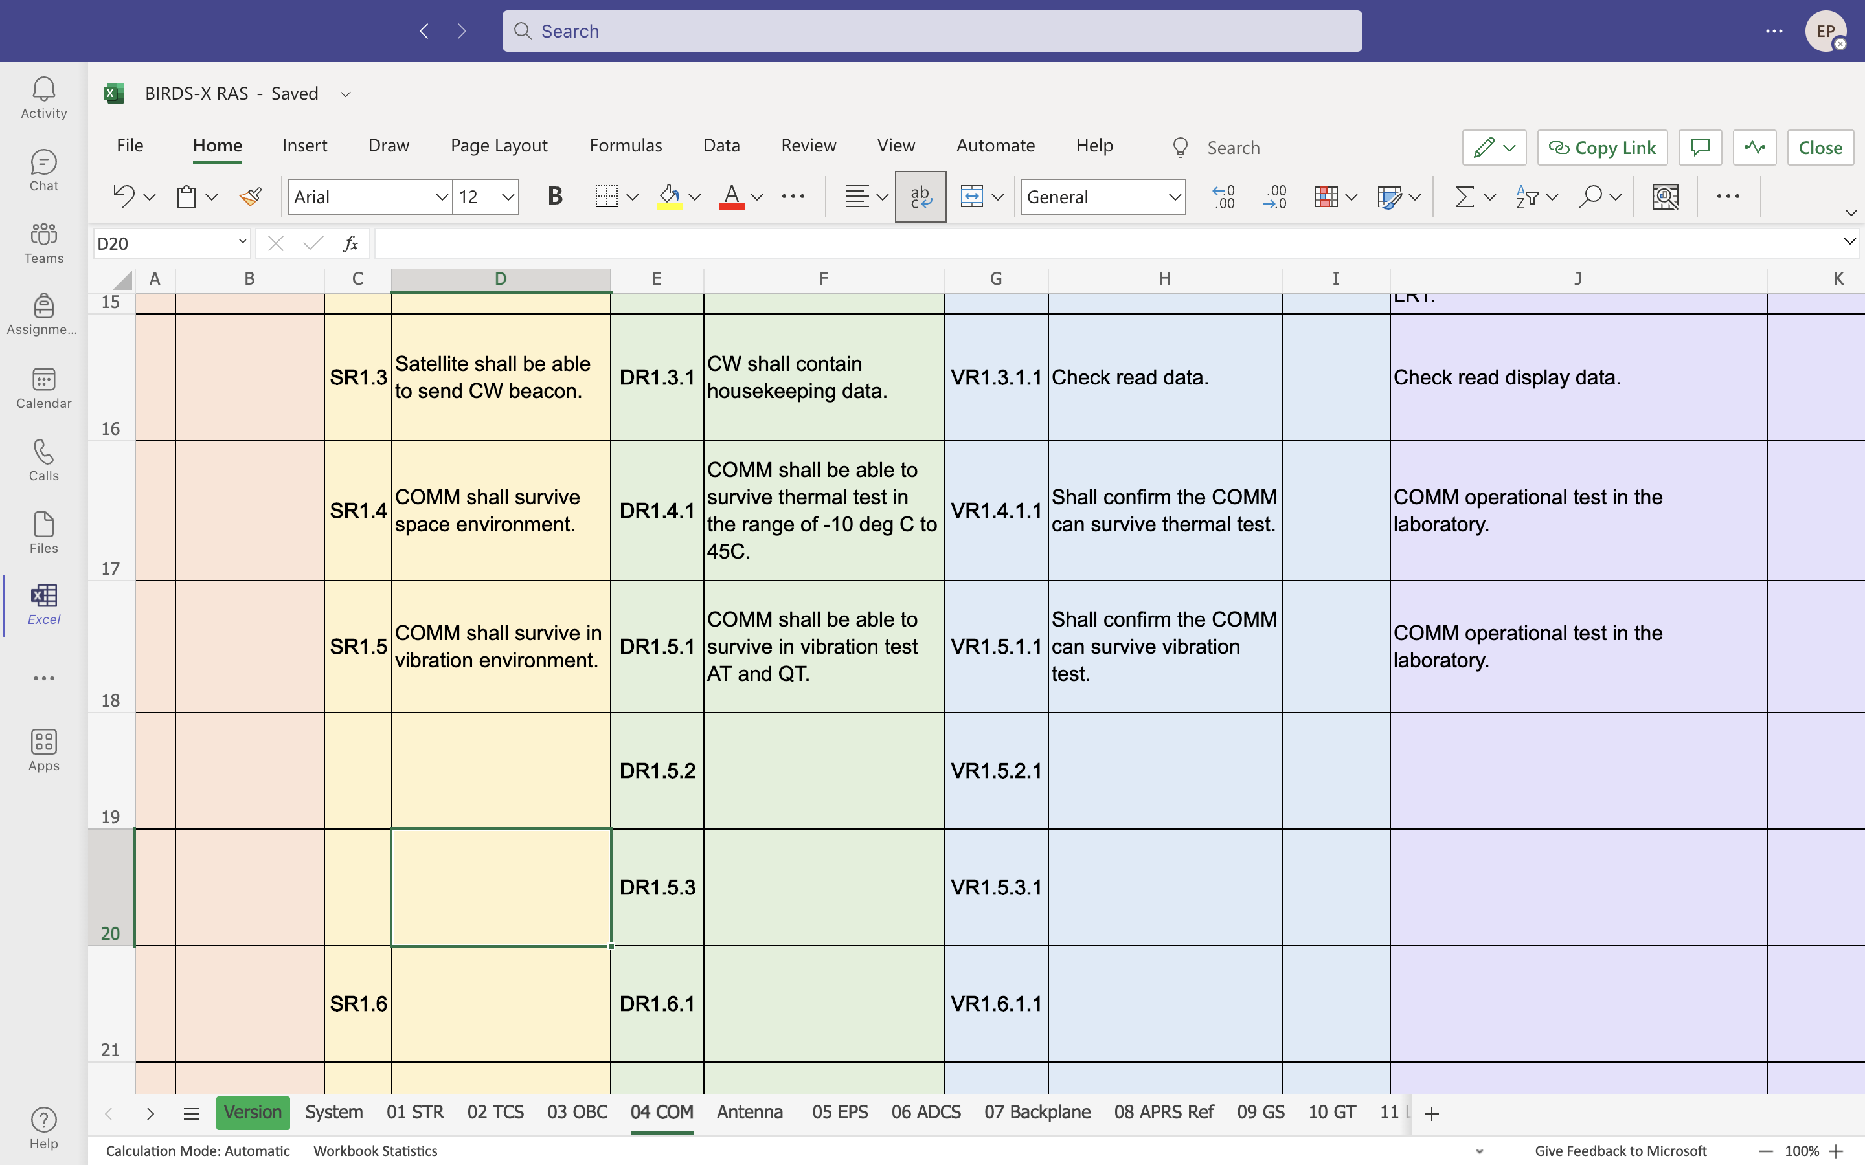
Communication RAS

Slide 13
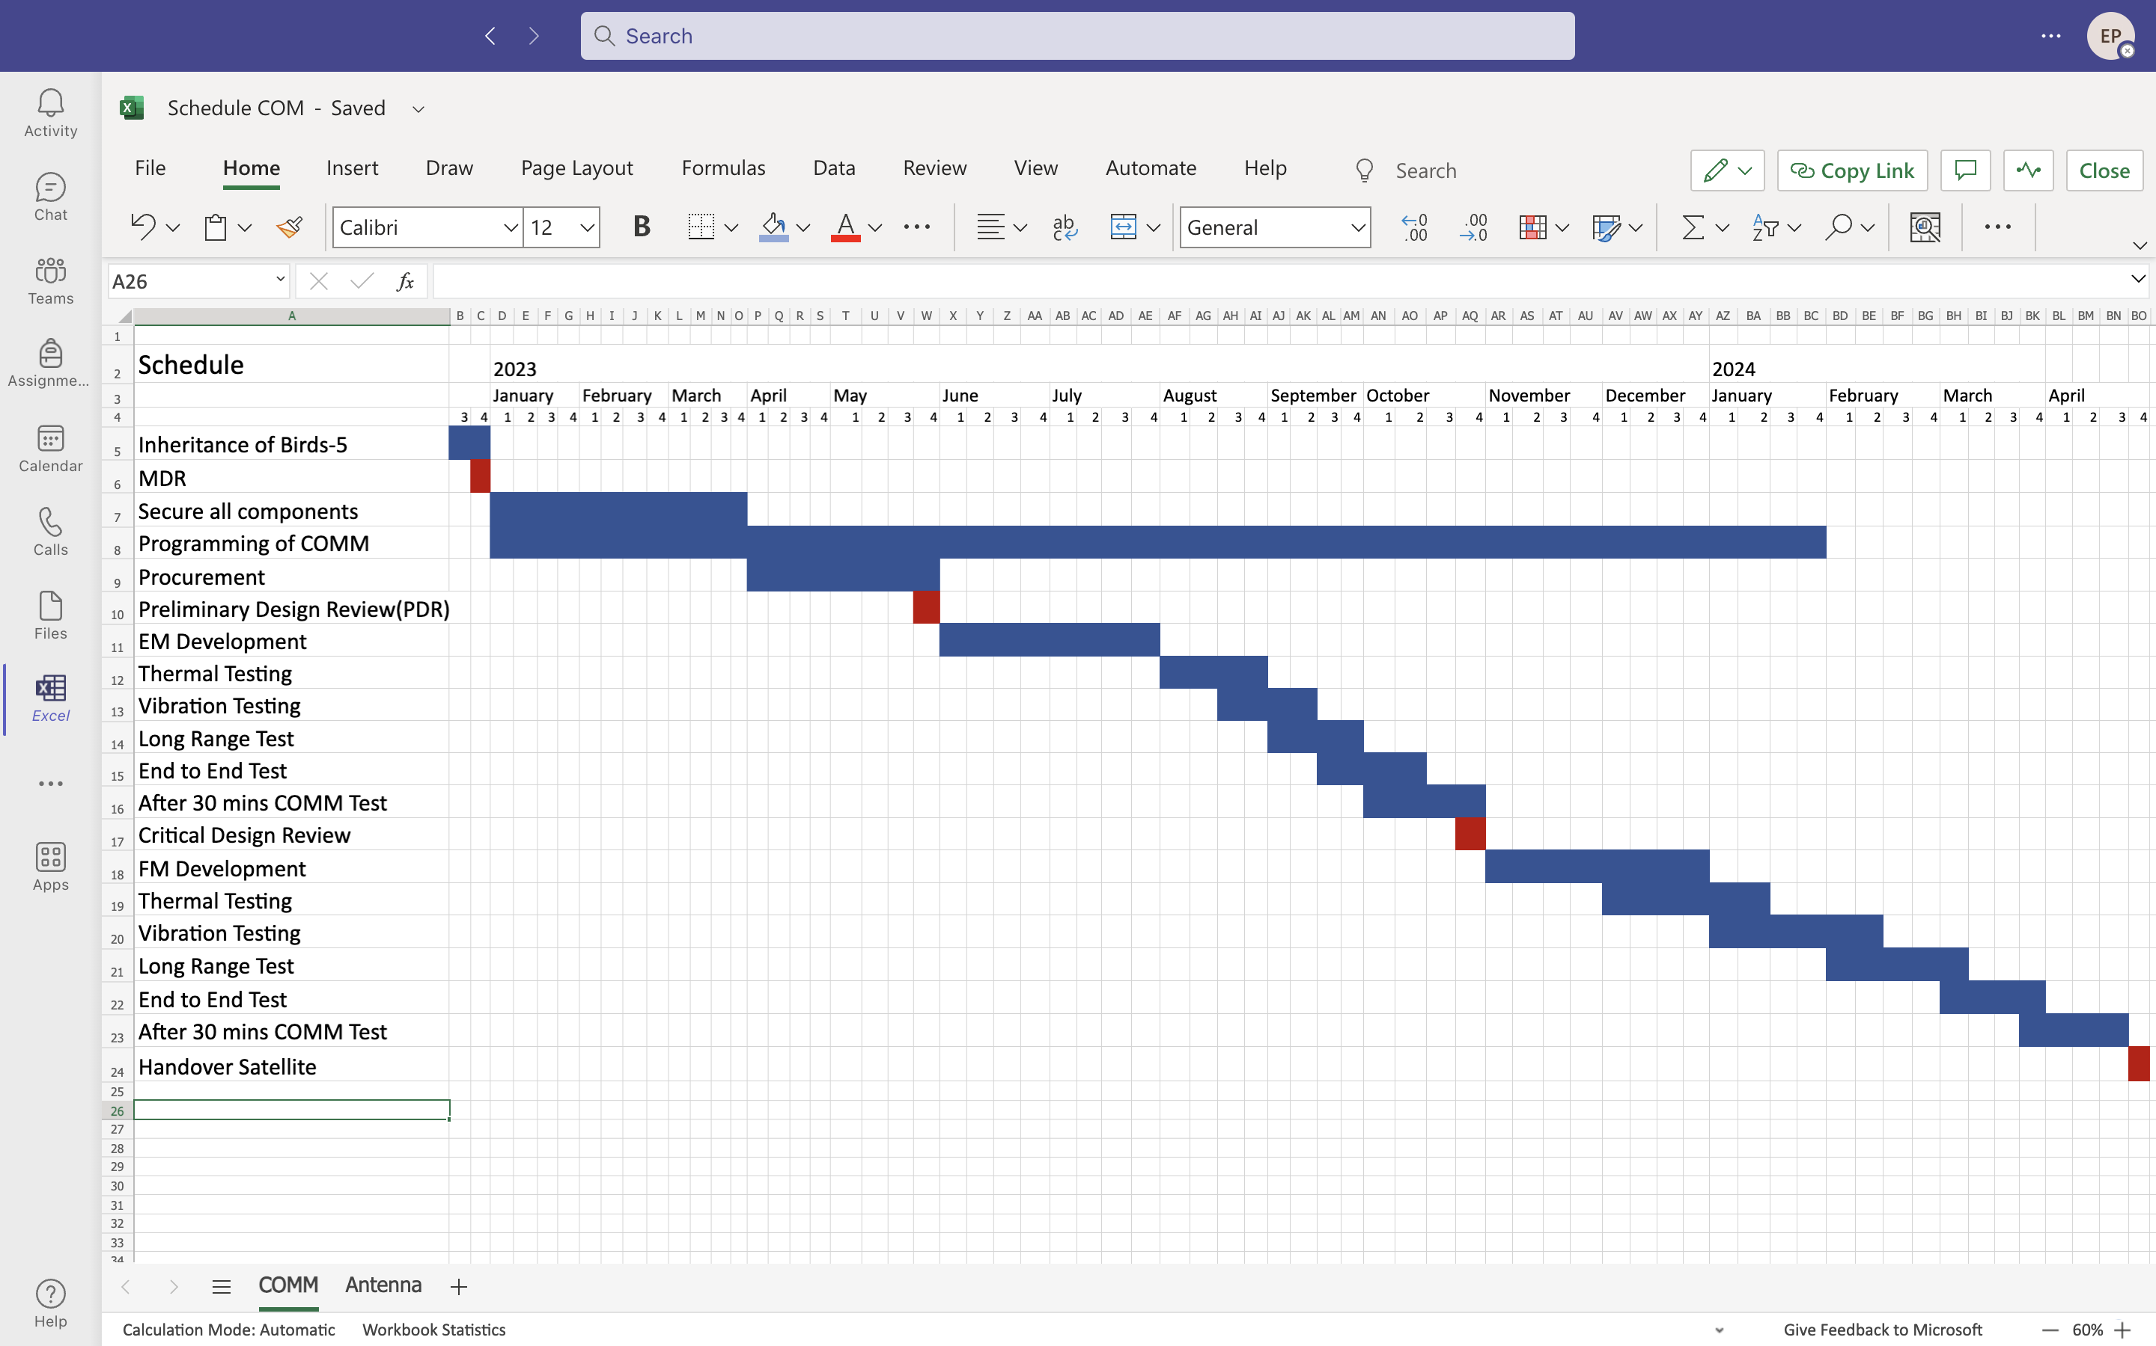
Communication Subsystem Schedule

Slide 14
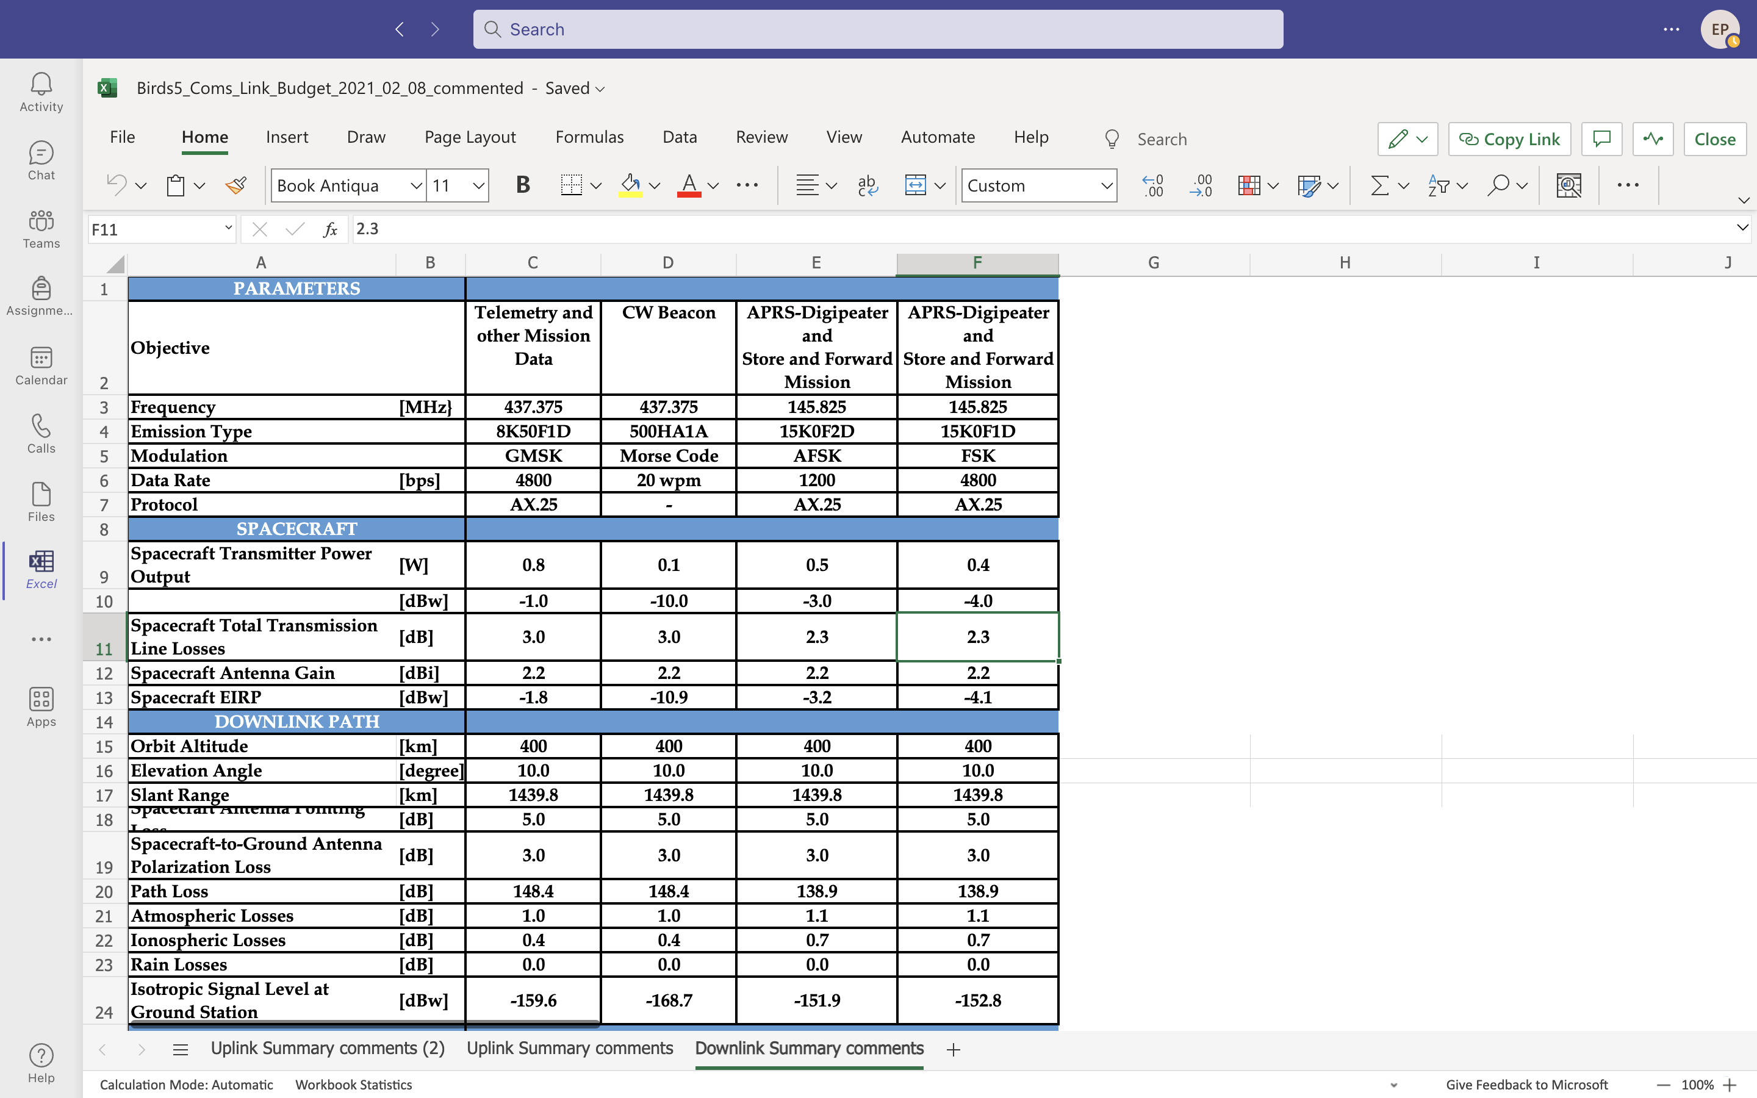
Link Budget

Slide 15
Antenna Deployment
By Ei Phyu Phyu

Slide 16
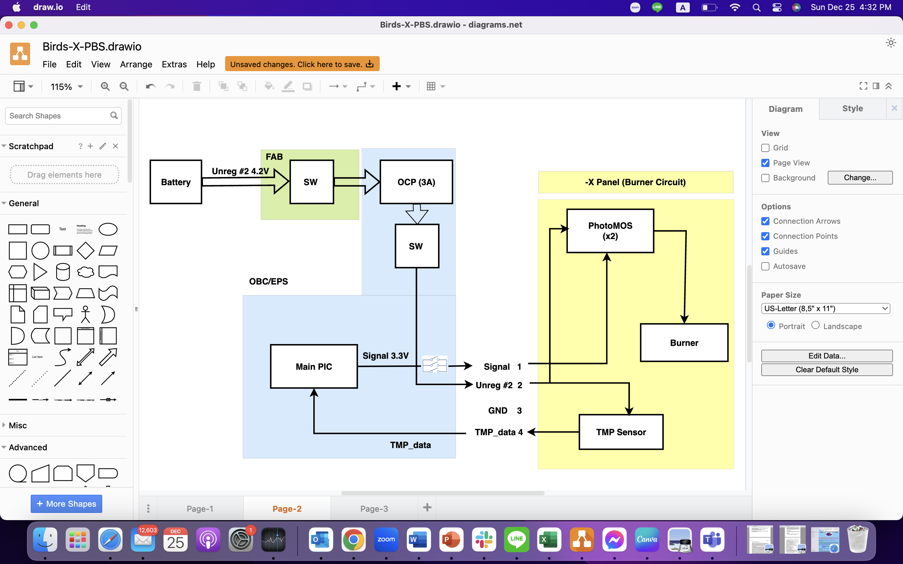
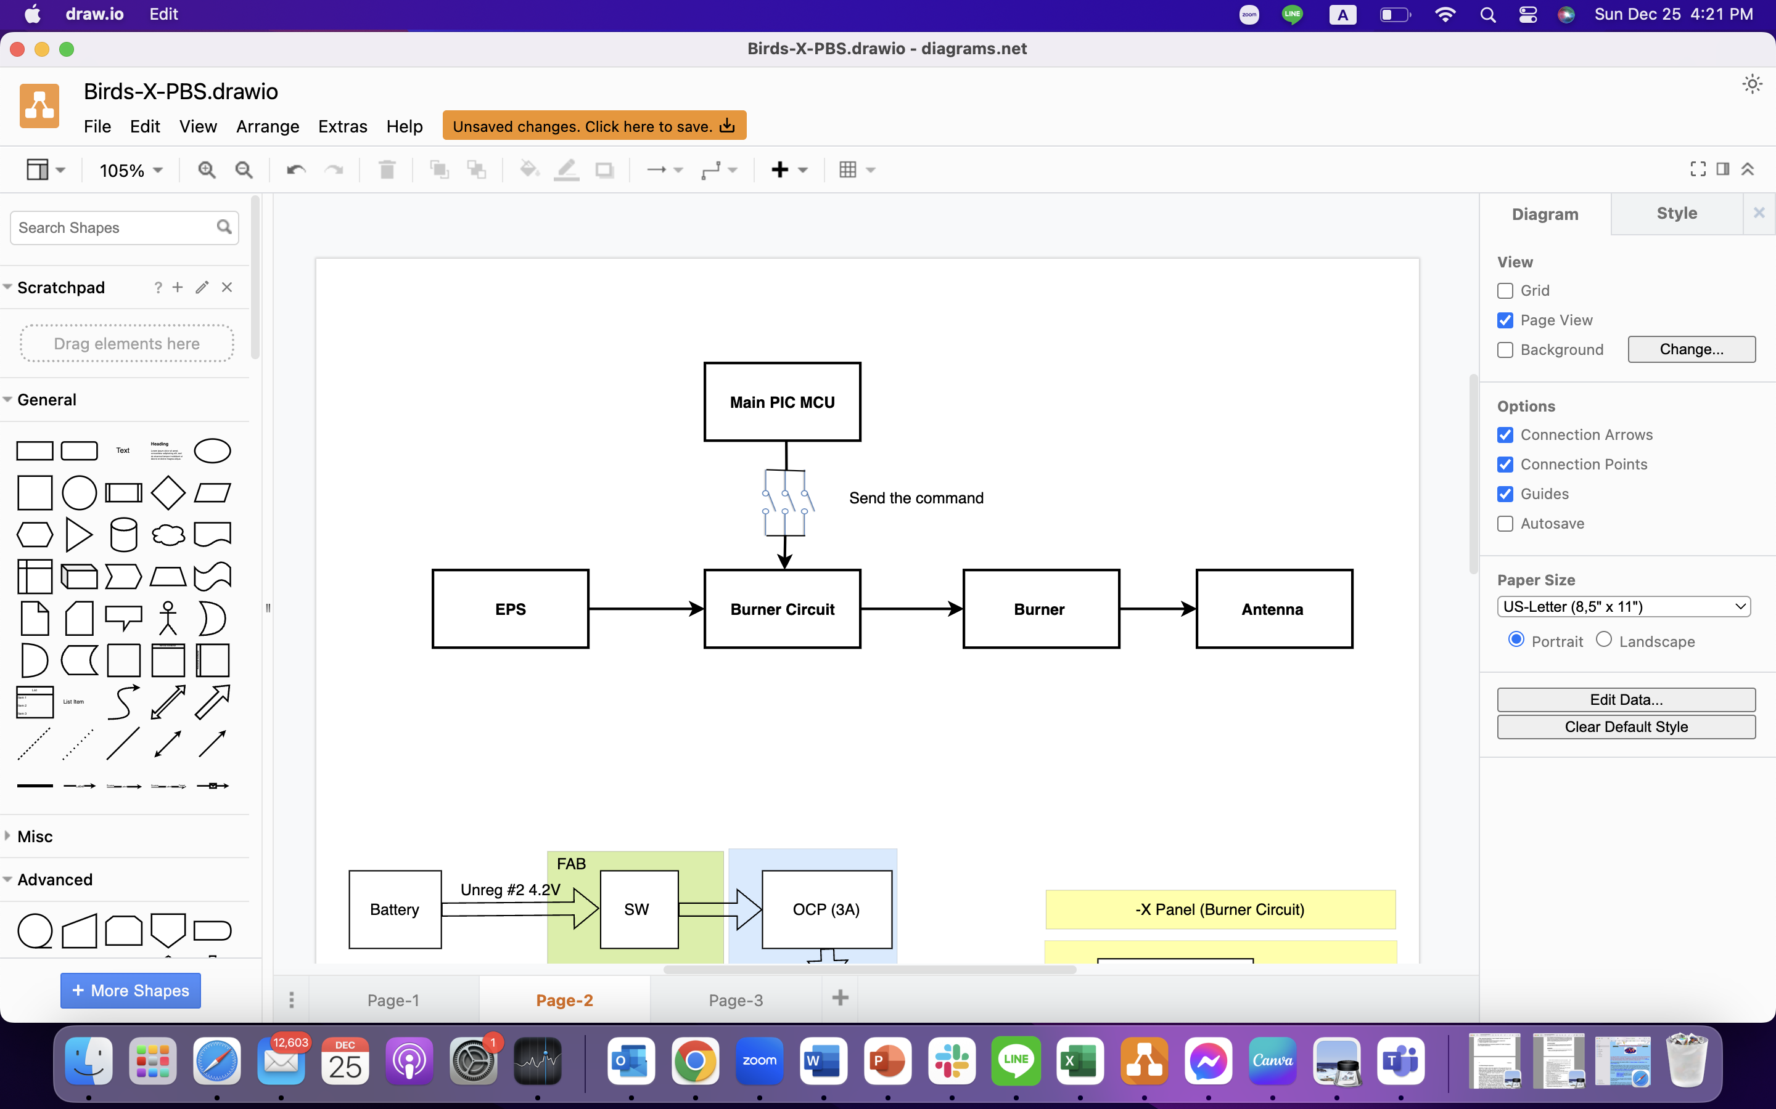
Block Diagram for Antenna Deployment
Antenna Deployment Block Diagram
Function - To achieve the deployment of UHF and VHF antenna successfully by using the burner circuit mechanism

Slide 17
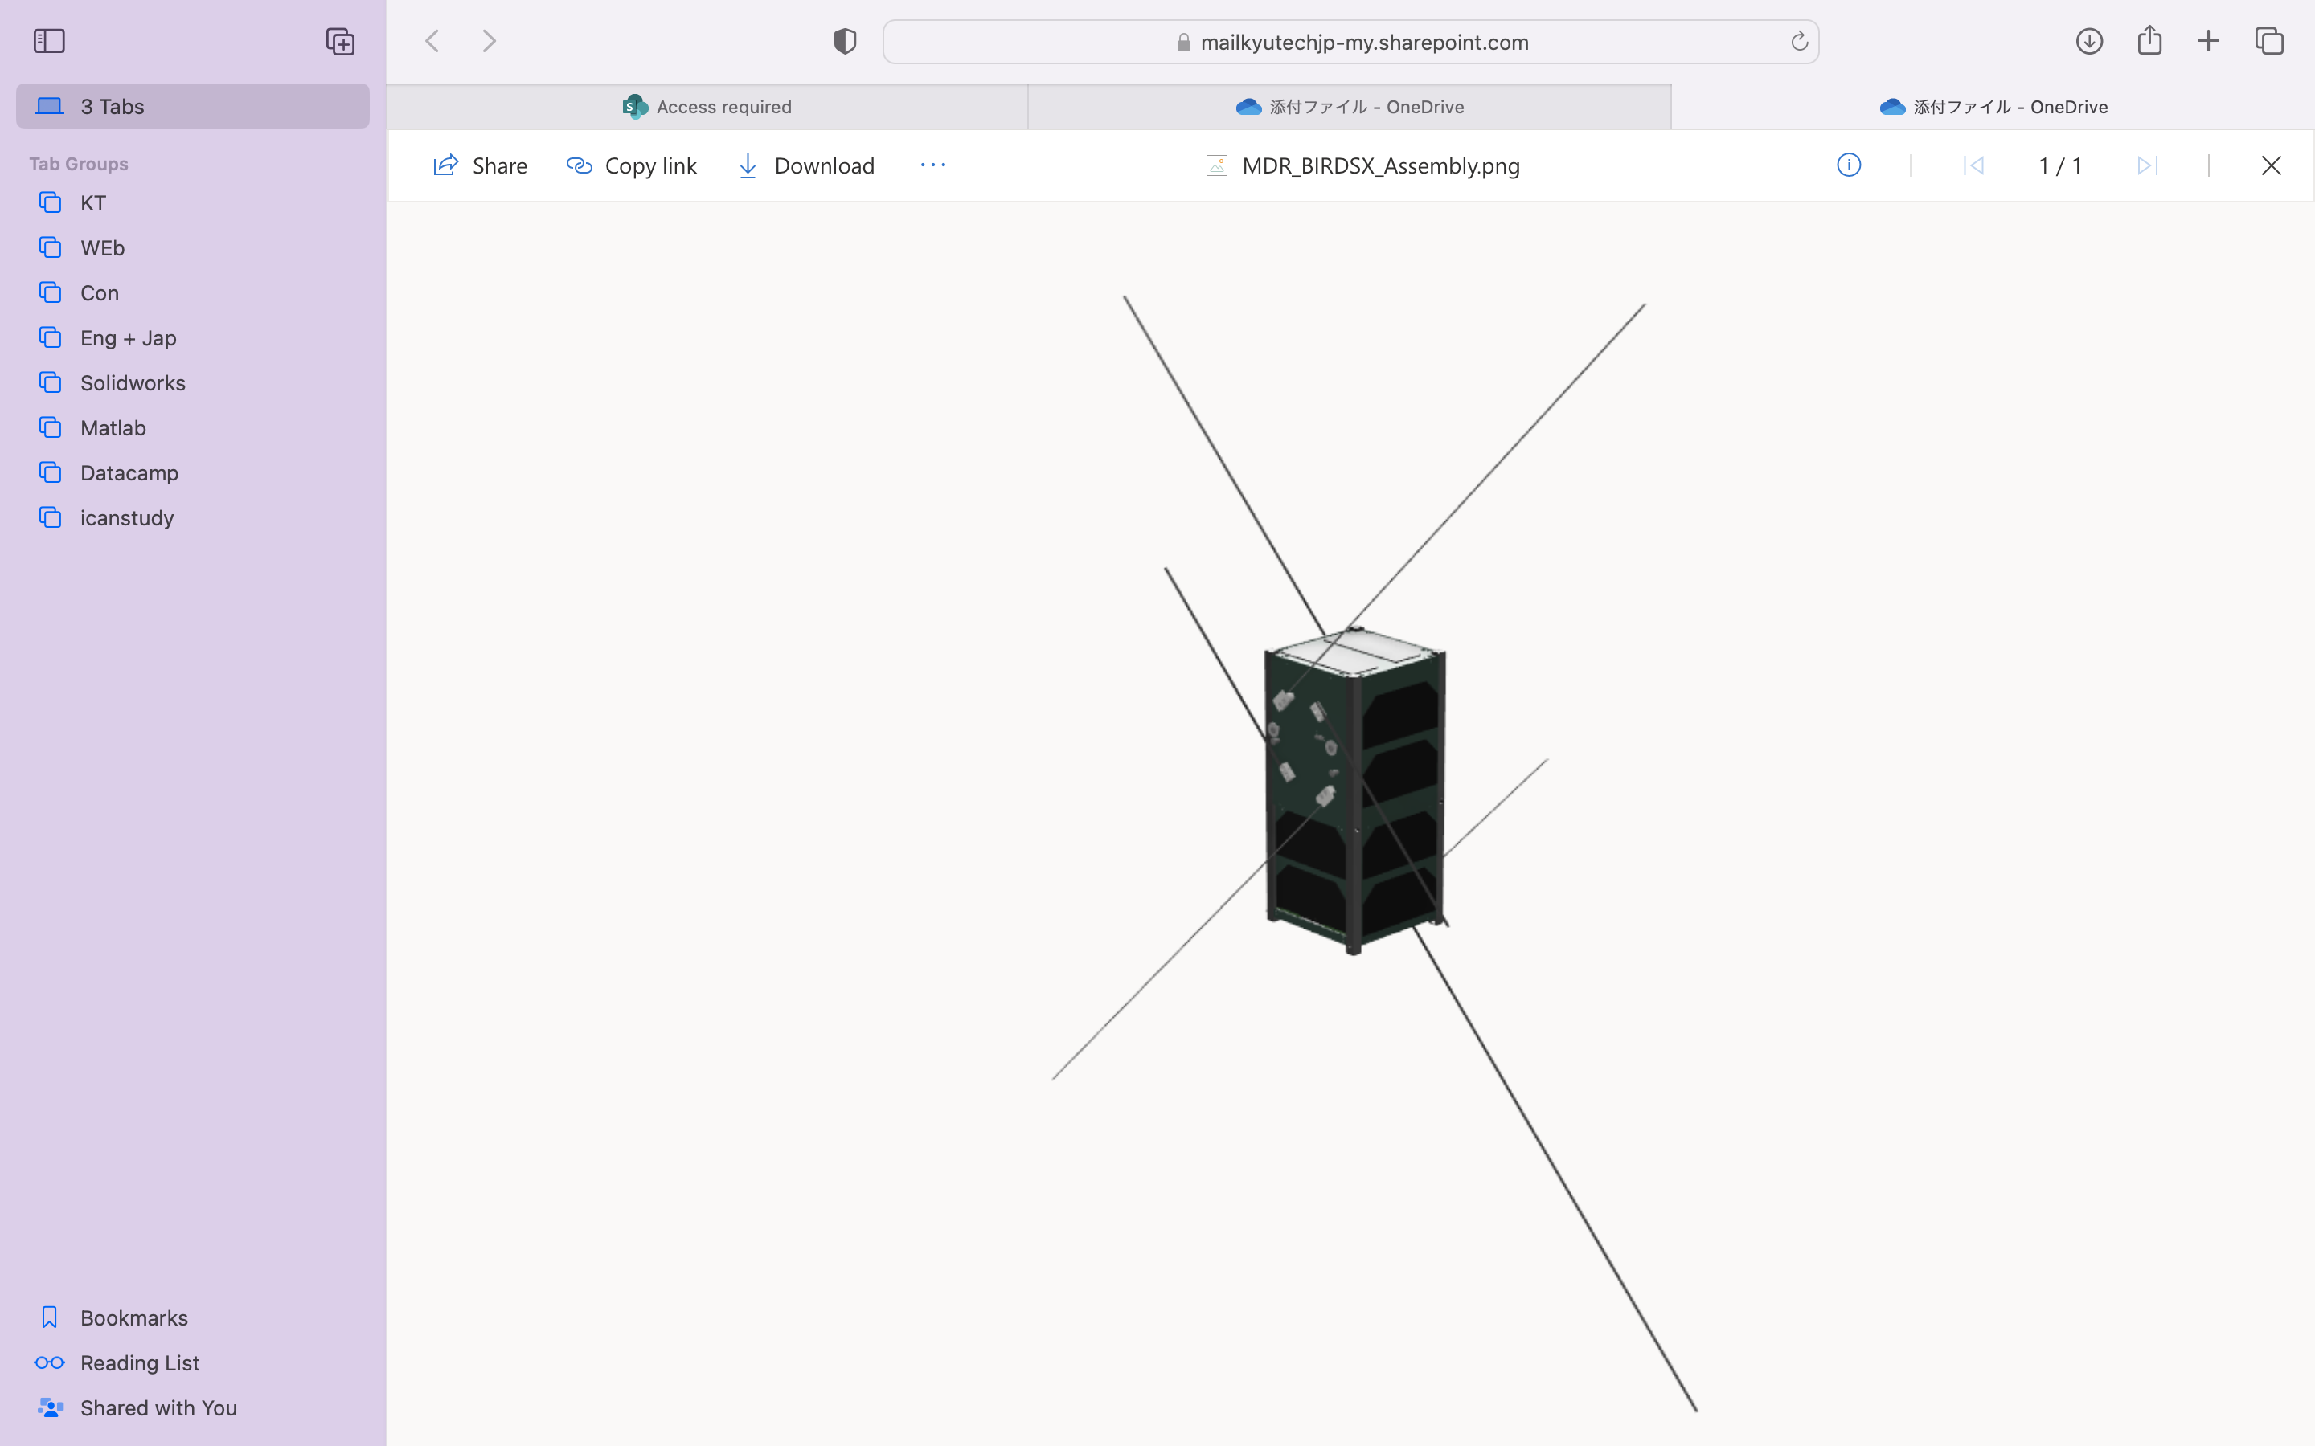
Antenna Configuration
1 VHF Antenna ​
- 5 APRS Payload and 1 APRS Reference mission
1 VHF Antenna ​
- 1 APRS Reference mission
1 UHF Antenna ​​
- New Transceiver
1 UHF Antenna ​
- Default CW & GMSK

Slide 18
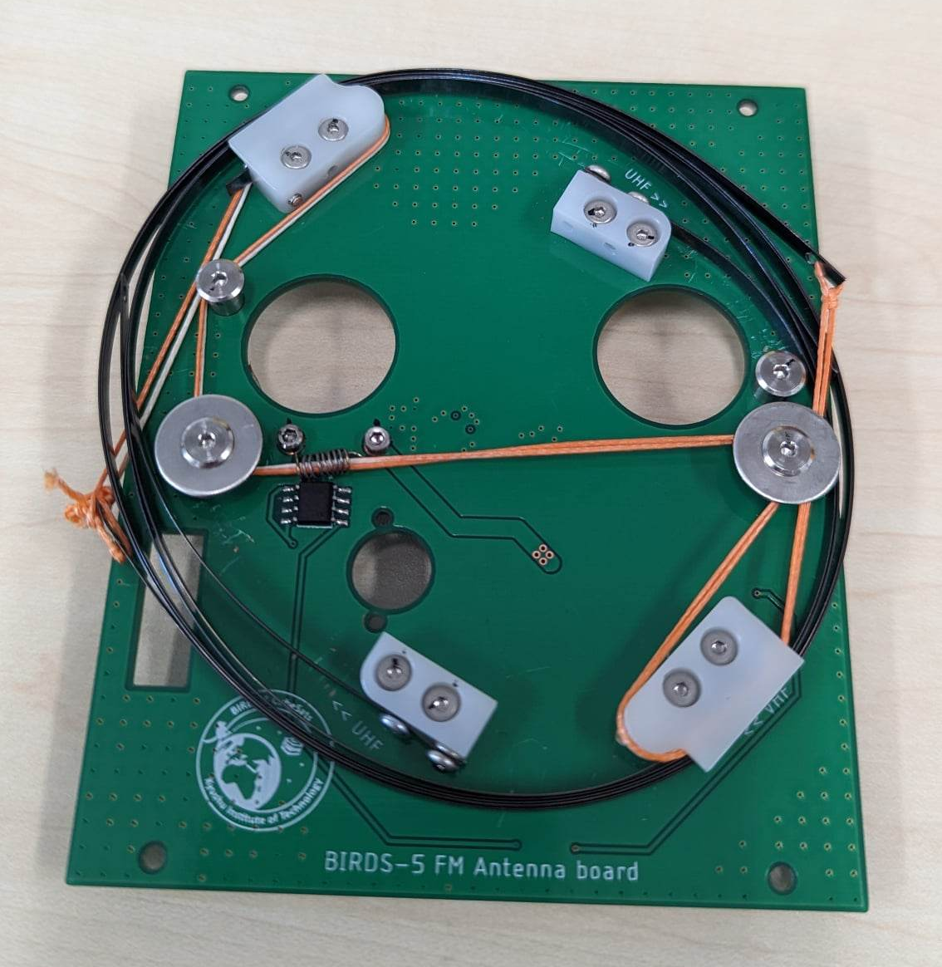
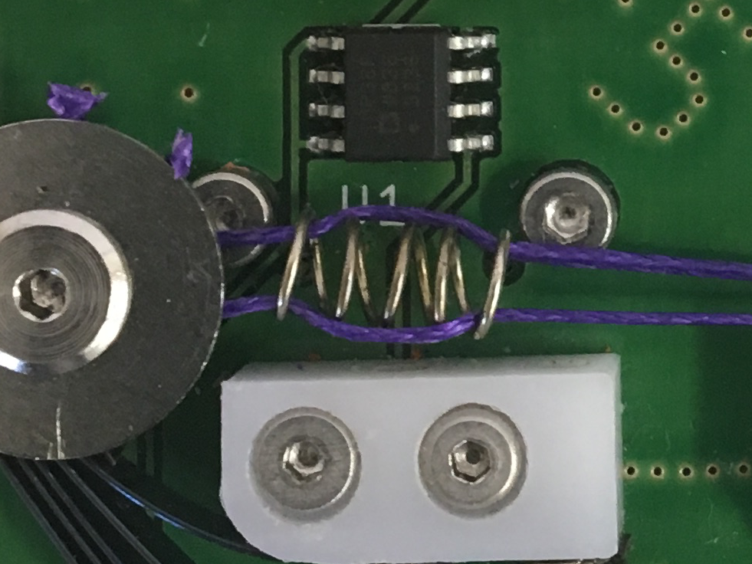
Antenna Board Birds-5
Nichrome wire

Slide 19
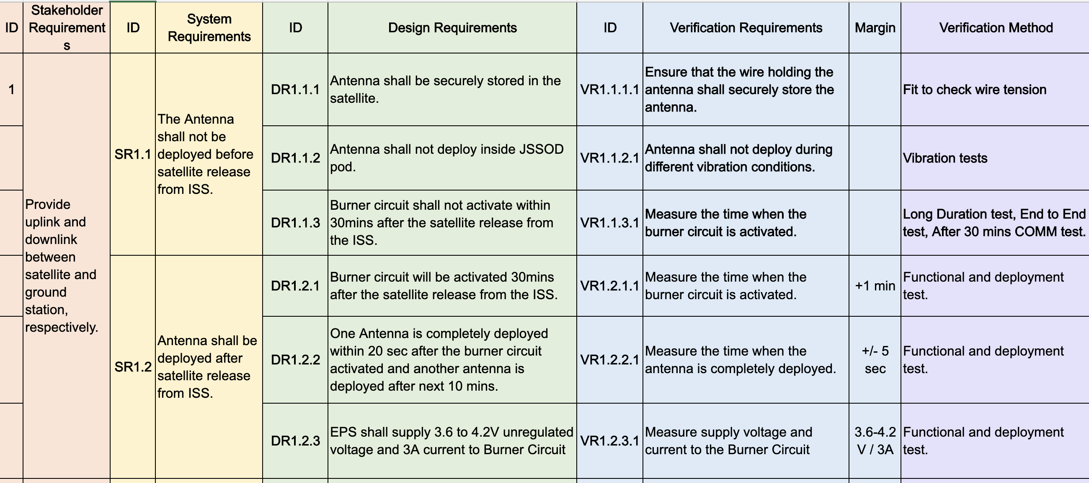
Antenna Deployment RAS

Slide 20
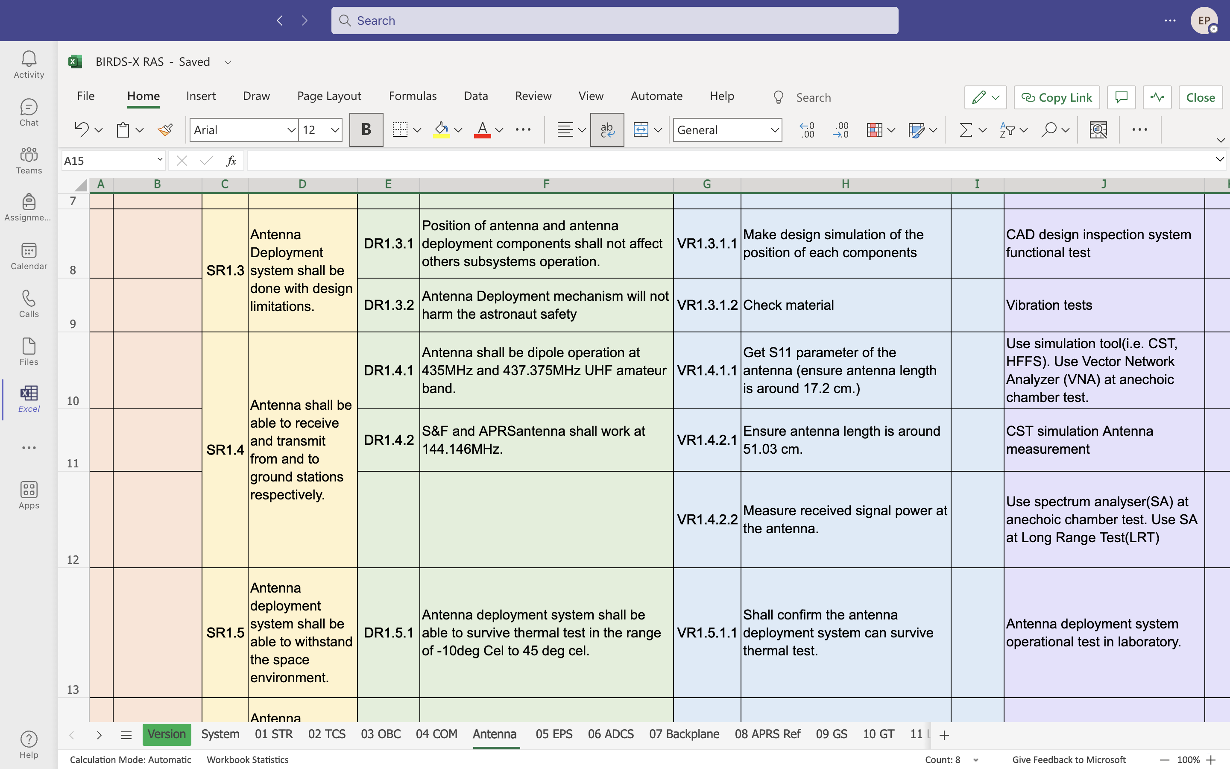
Antenna Deployment RAS

Slide 21
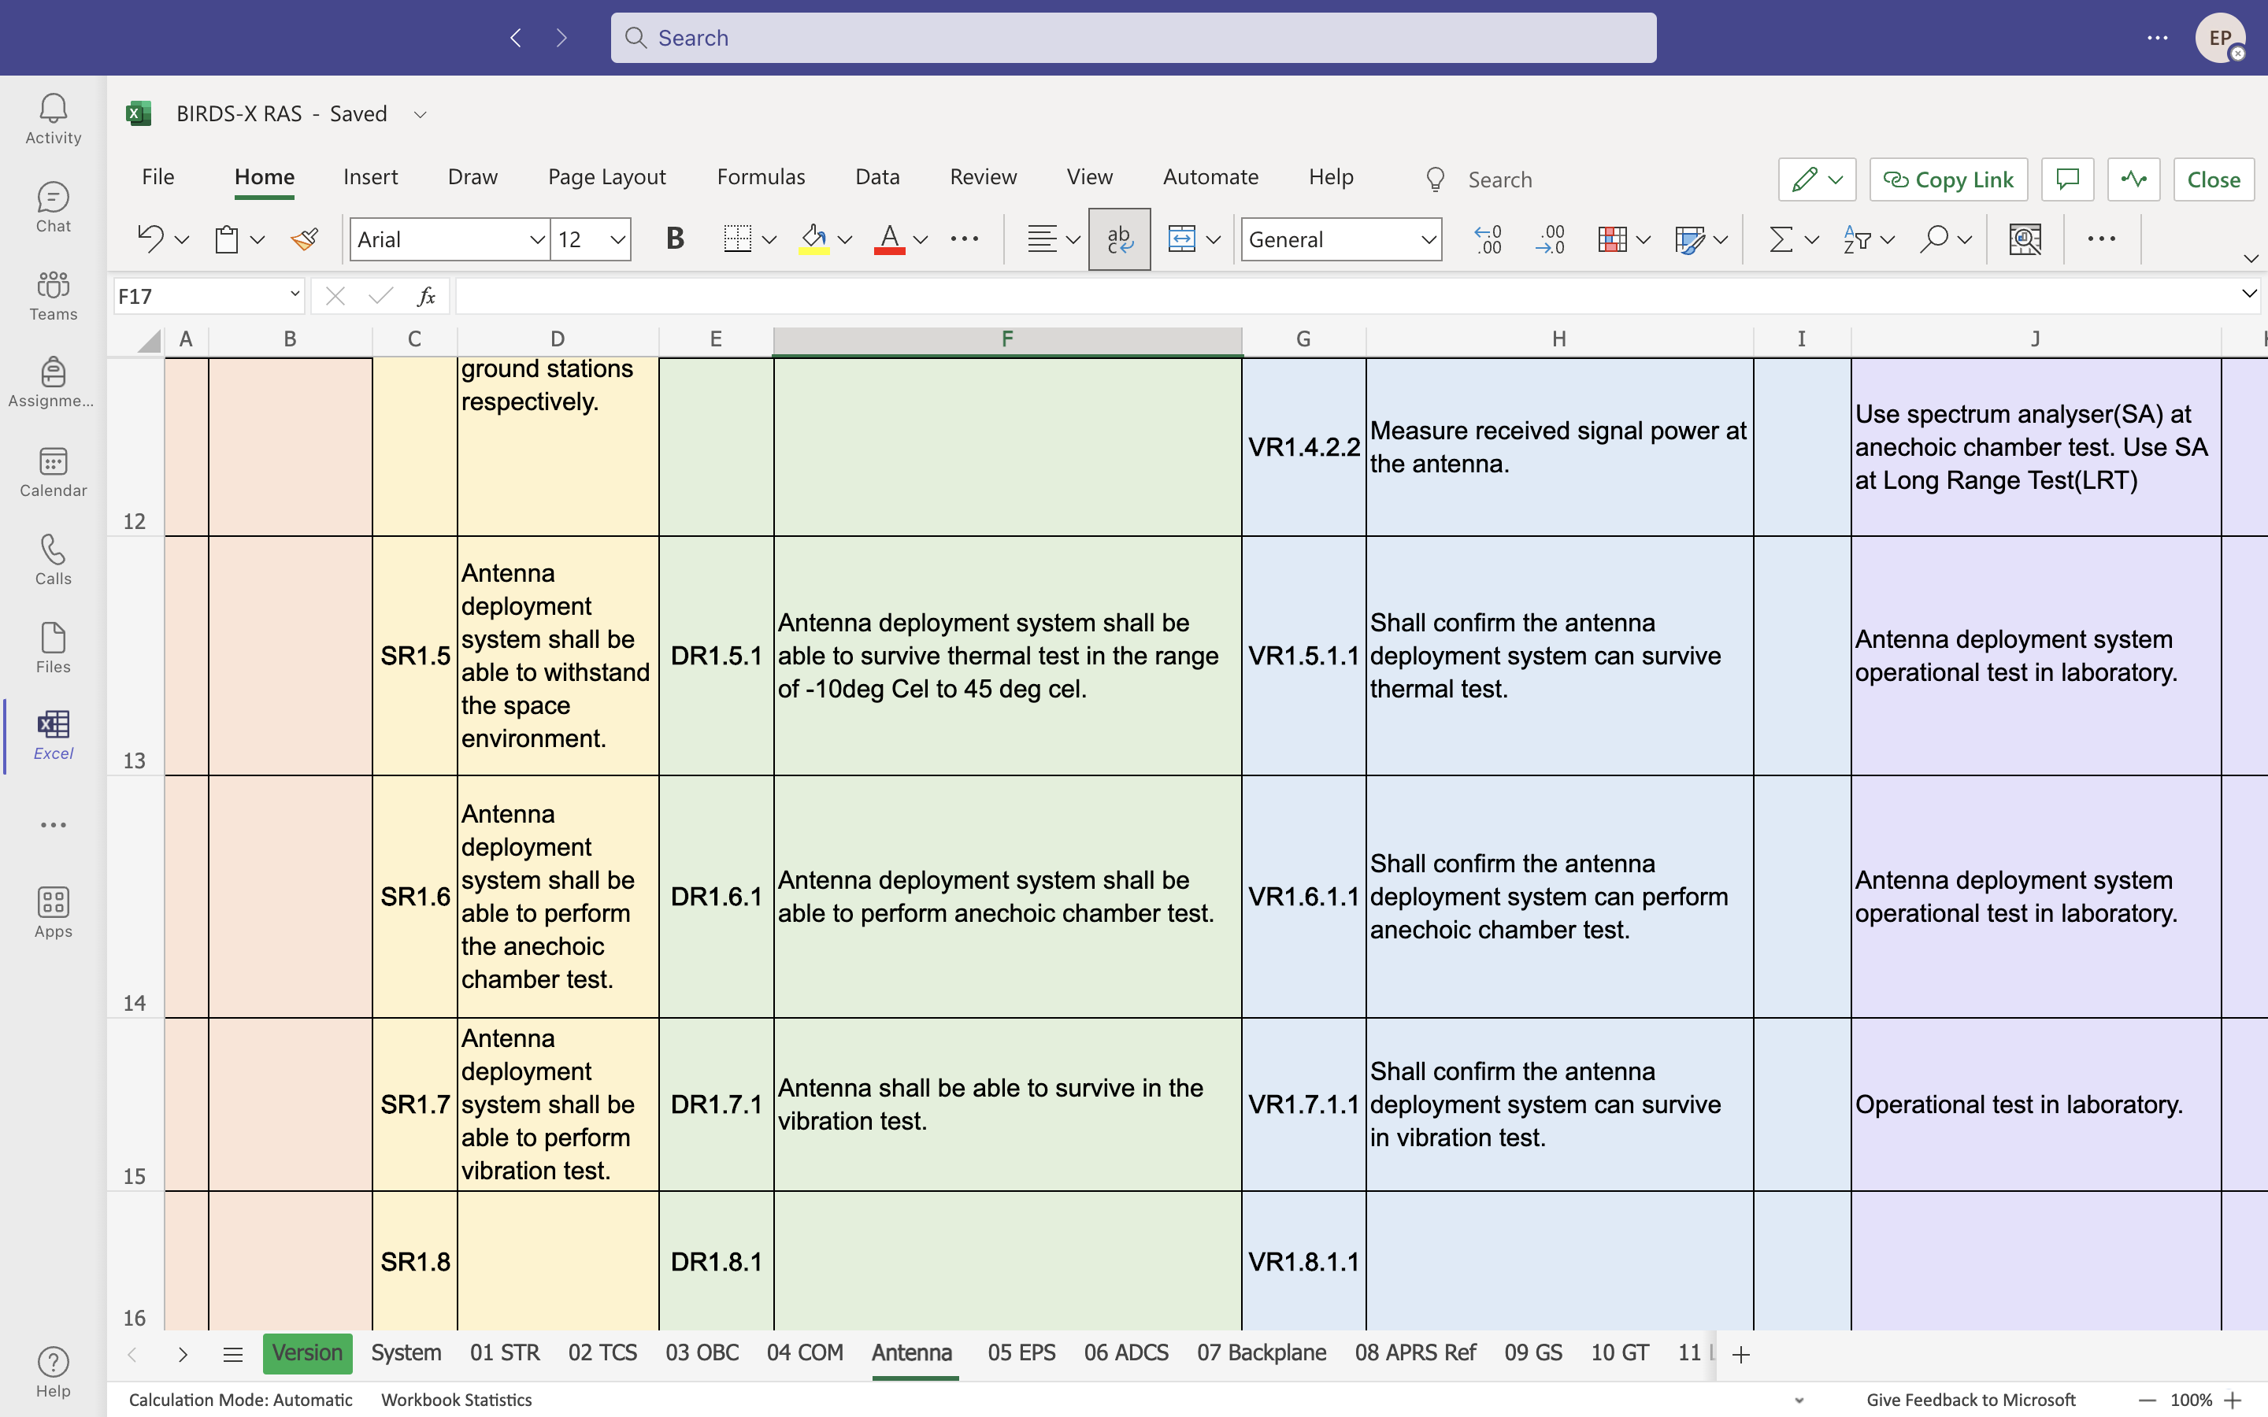
Antenna Deployment RAS

Slide 22
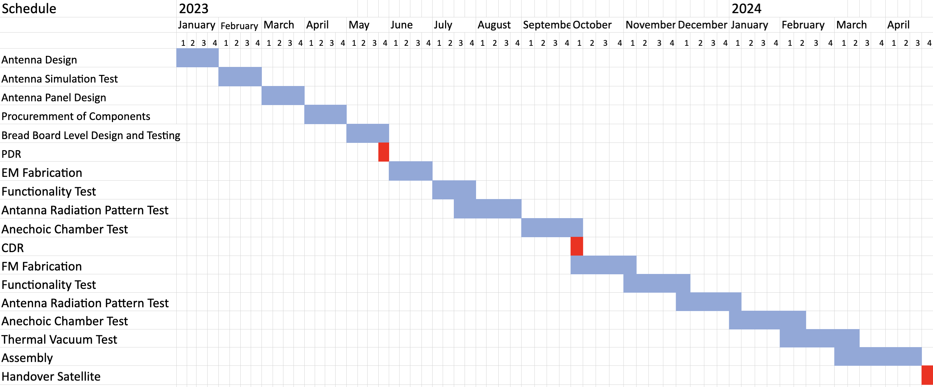
Antenna Subsystem Schedule

